Slide 1
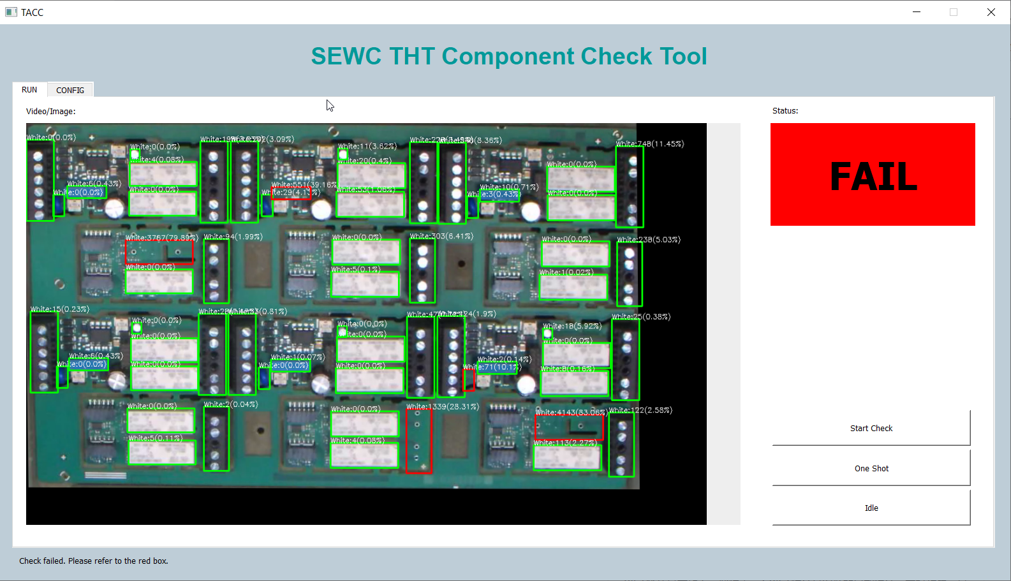
THT Assembly Check using Computer Vision
Overview
Challenges
Procedure
Demonstration
Future Directions
PU ENG1 Zhong

Slide 2
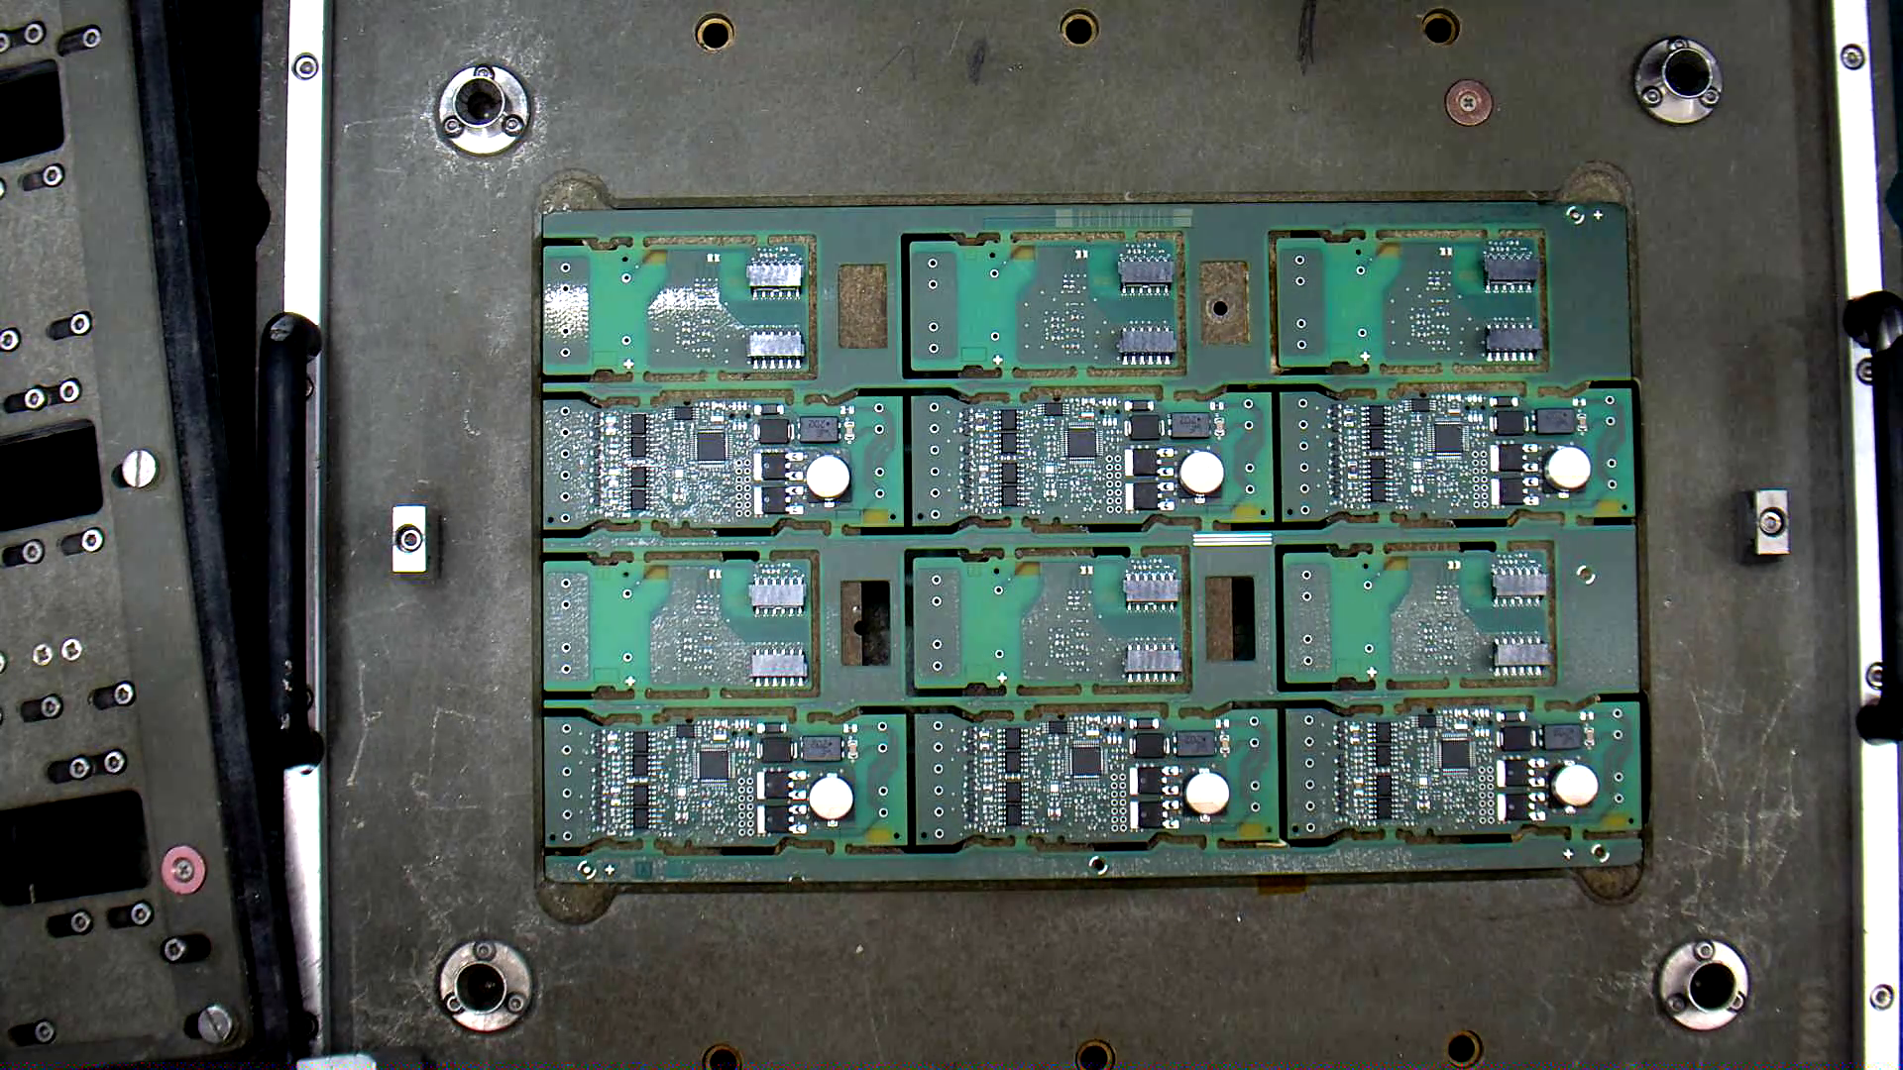
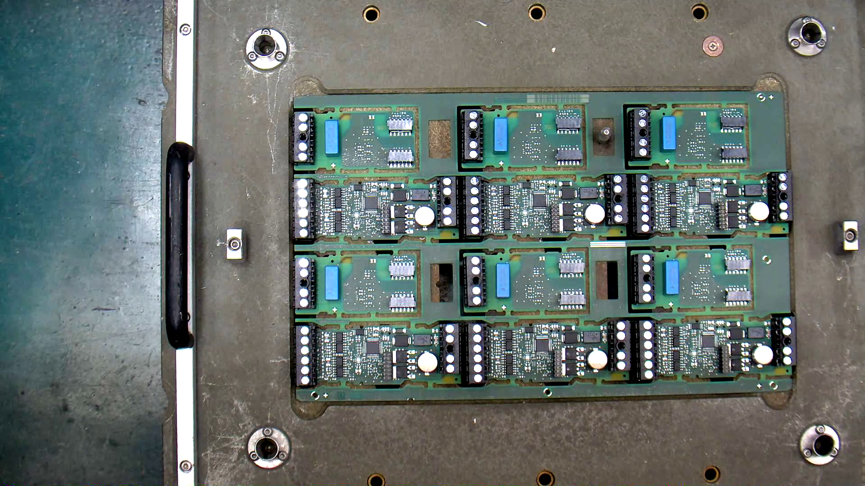
Overview
Overview
Challenges
Procedure
Demonstration
Future Directions
THT Assembly Station
Manual Installation of electronic components. Components are installed into holes on the PCBs, and are soldered onto PCBs immediately after installation.

Slide 3
Overview
Overview
Challenges
Procedure
Demonstration
Future Directions
THT Assembly Station: Problem
During manual installation, there is risk of missing components and wrong components.

Slide 4
Overview
Overview
Challenges
Procedure
Demonstration
Future Directions
THT Assembly Station: Solution
Current solution:
Use Fool-proofing Fixture Boards to check if there is any missing components or incorrectly installed components.
Lack of versatility:
Every type of PCB needs a fixture board specially designed.
Expensive:
Fixture boards cost a lot of money.

Slide 5
Overview
Overview
Challenges
Procedure
Demonstration
Future Directions
THT Assembly Station: Solution
Our new solution:
Use classical Computer Vision to check installation of components
Versatility:
Switch config files instead of special designed fixture boards.
Cheap:
Camera costs far less than fixture boards, and only one camera is needed per station.

Slide 6
Challenges
Overview
Challenges
Procedure
Demonstration
Future Directions
Challenges
1. Bad image capturing environment
2. When to trigger the check
3. Location of PCBs is not fixed
4. Must be easy to configure new PCB types

Slide 7
Challenges
Overview
Challenges
Bad environment
Triggering
Not fixed location
Flexible configs
Procedure
Demonstration
Future Directions
Challenges: Bad image capturing environment
Solution:
Add extra lighting on the station.
Tilt the camera, let the camera capture images with certain angle instead of vertically. This step is to reduce the effect comes from light reflections.

Slide 8
Challenges
Overview
Challenges
Bad environment
Triggering
Not fixed location
Flexible configs
Procedure
Demonstration
Future Directions
Challenges: When to trigger the check
Need a trigger to tell system to start check, otherwise the system will be always checking PCB during installation procedure and reporting false failure.

Slide 9
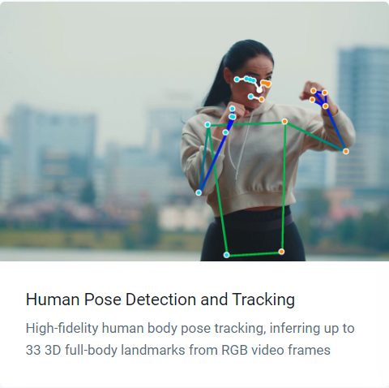
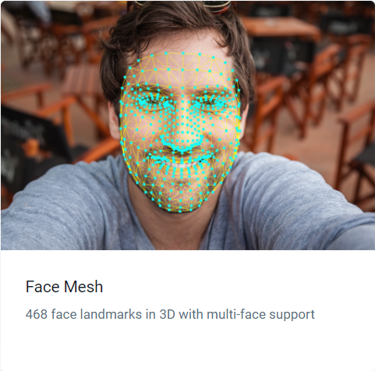
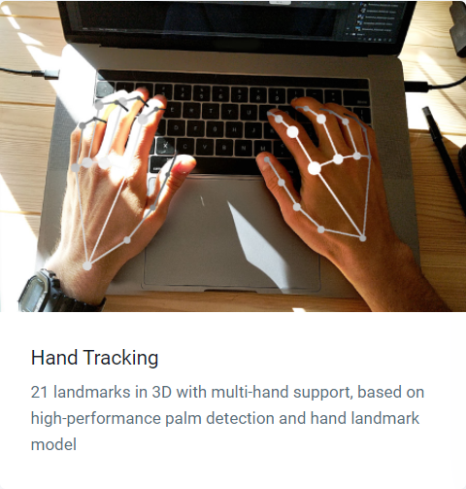
Challenges
Overview
Challenges
Bad environment
Triggering
Not fixed location
Flexible configs
Procedure
Demonstration
Future Directions
Solution: Gesture trigger using Mediapipe
Mediapipe: Google open source AI library for human detections

Slide 10
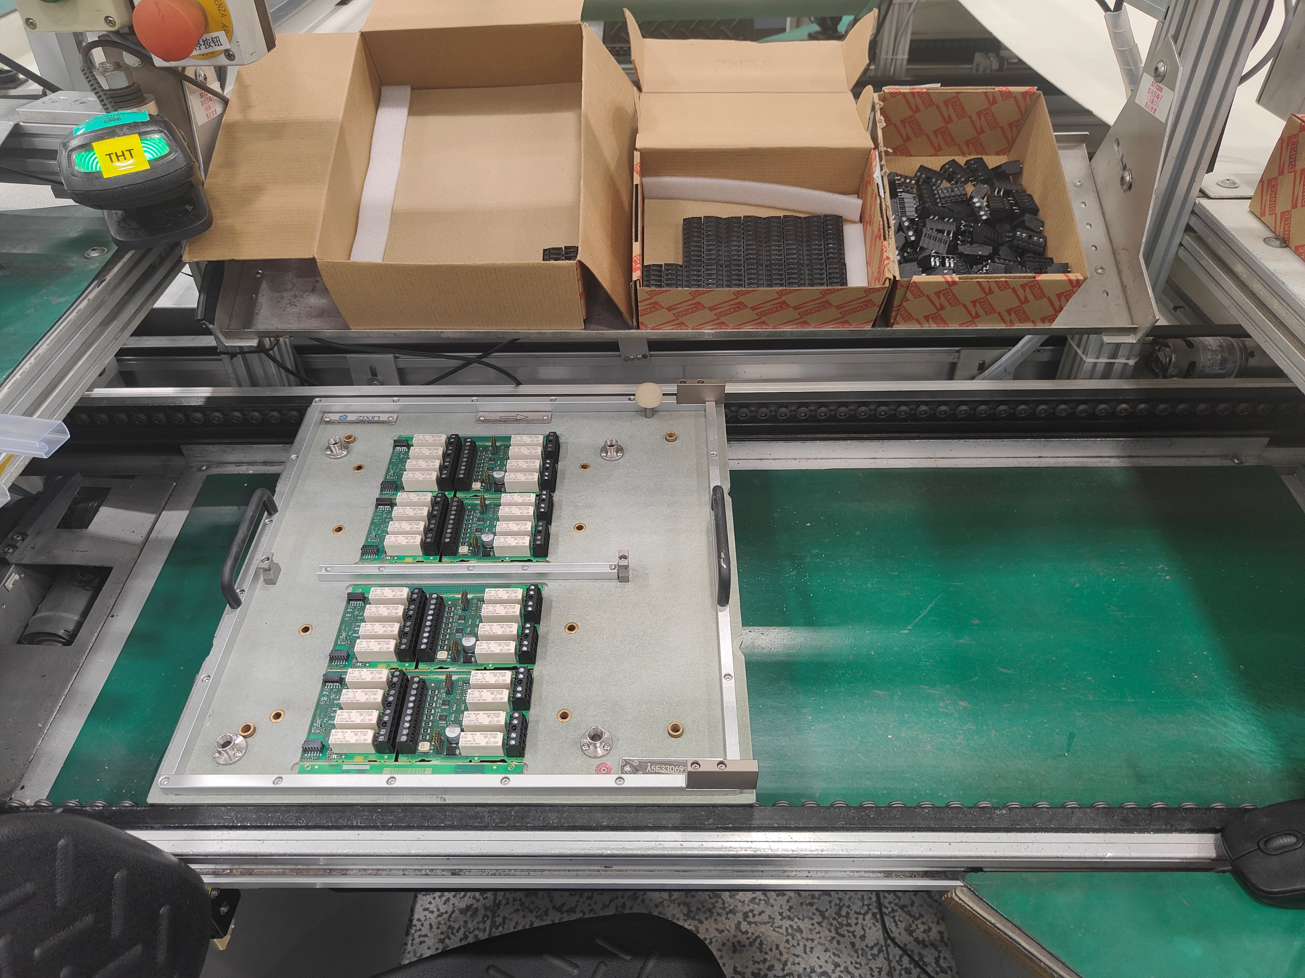
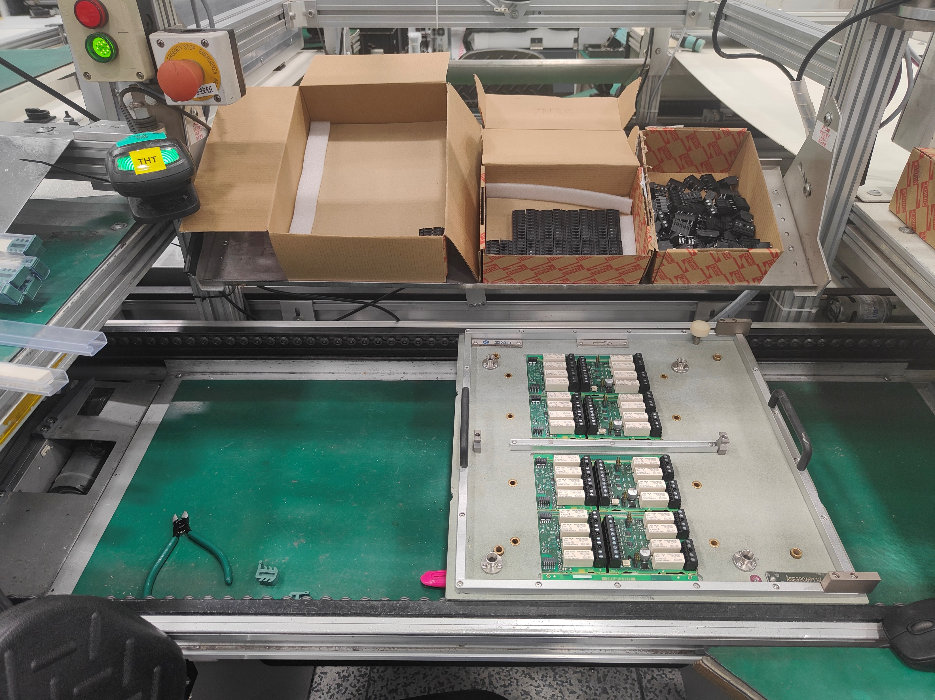
Challenges
Overview
Challenges
Bad environment
Triggering
Not fixed location
Flexible configs
Procedure
Demonstration
Future Directions
Challenges: Location of PCBs is not fixed
PCB moves left and right freely

Slide 11
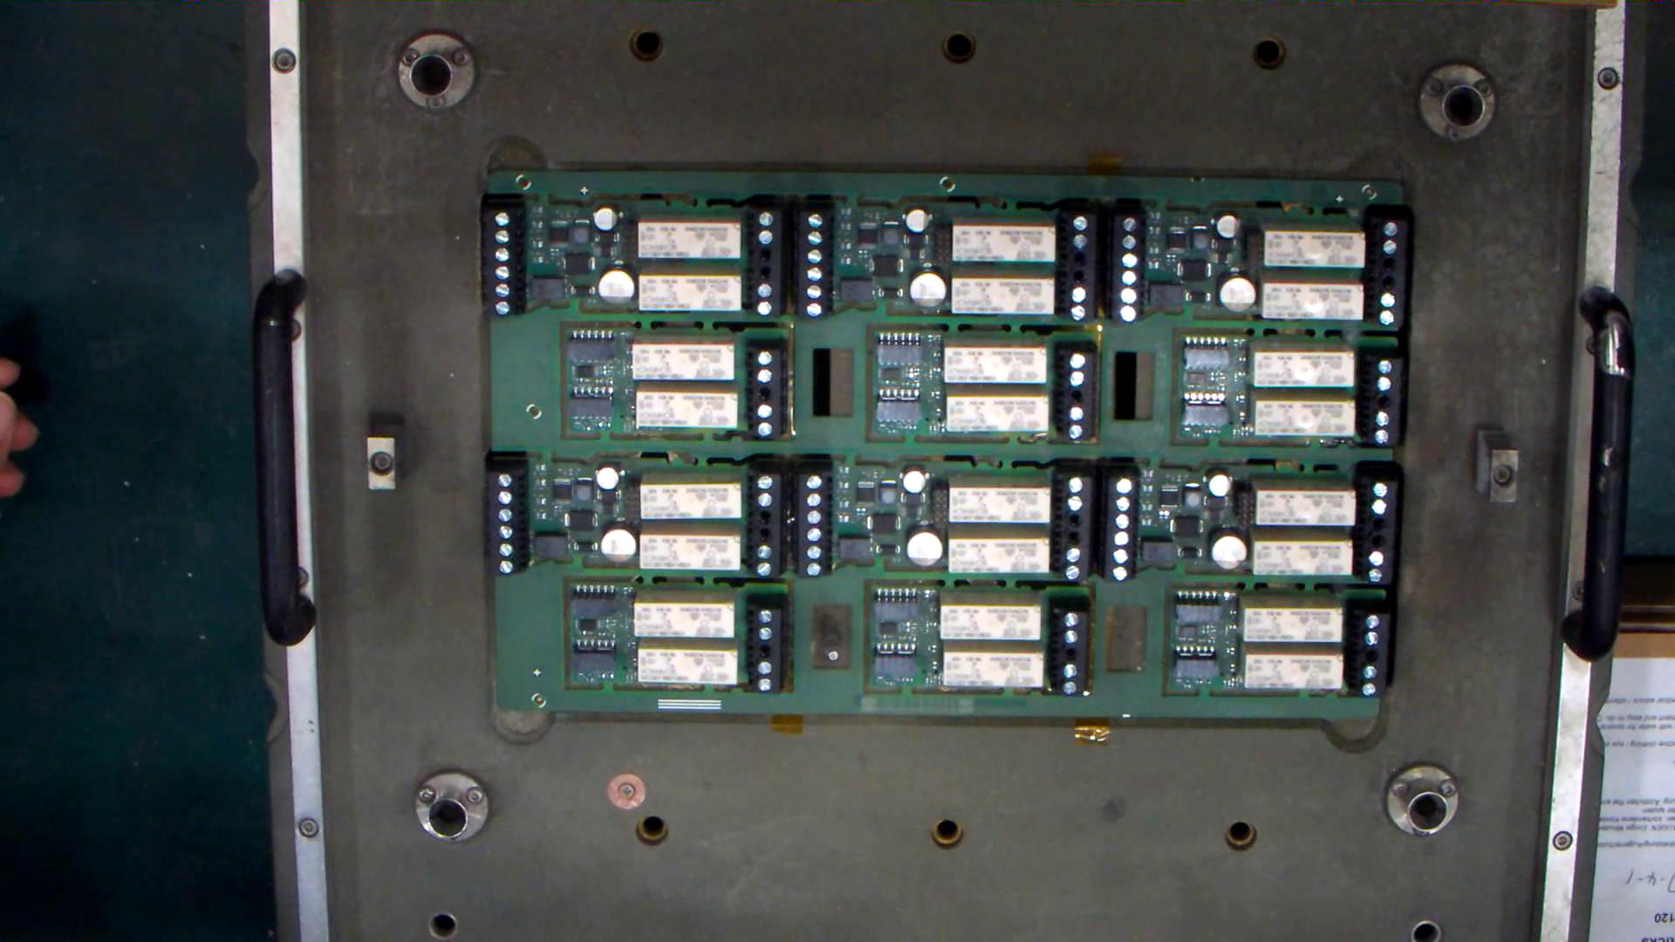
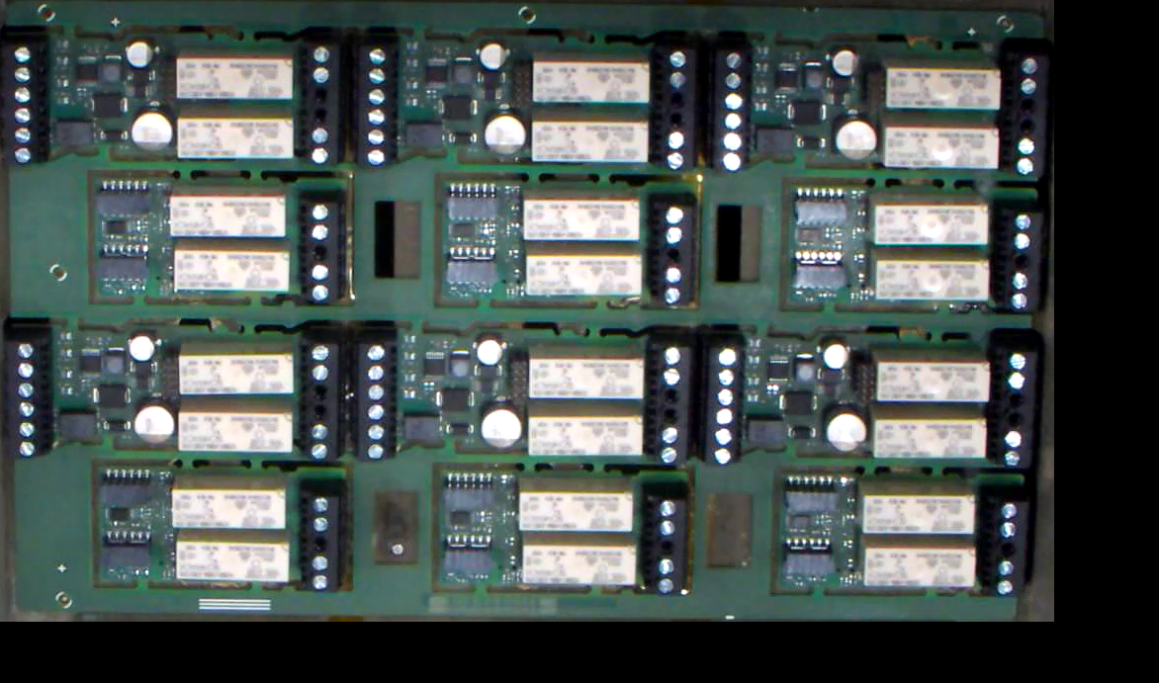
Challenges
Overview
Challenges
Bad environment
Triggering
Not fixed location
Flexible configs
Procedure
Demonstration
Future Directions
Solution
Use computer vision algorithms to compute and capture the location of PCB area.

Slide 12
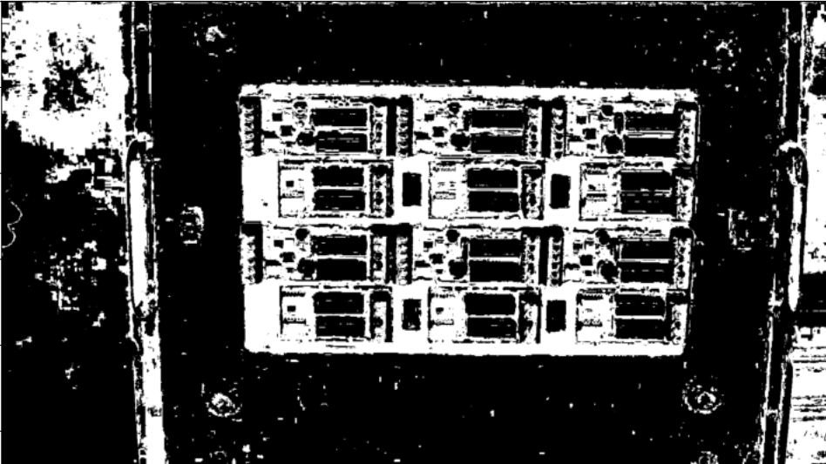
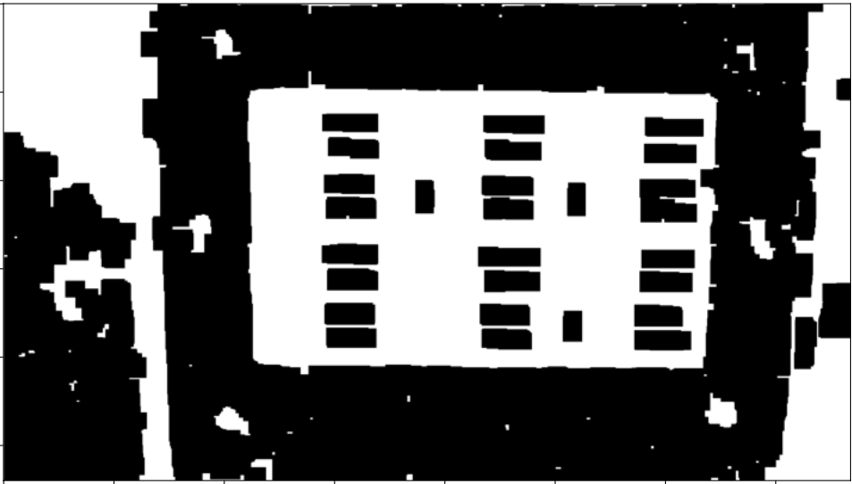
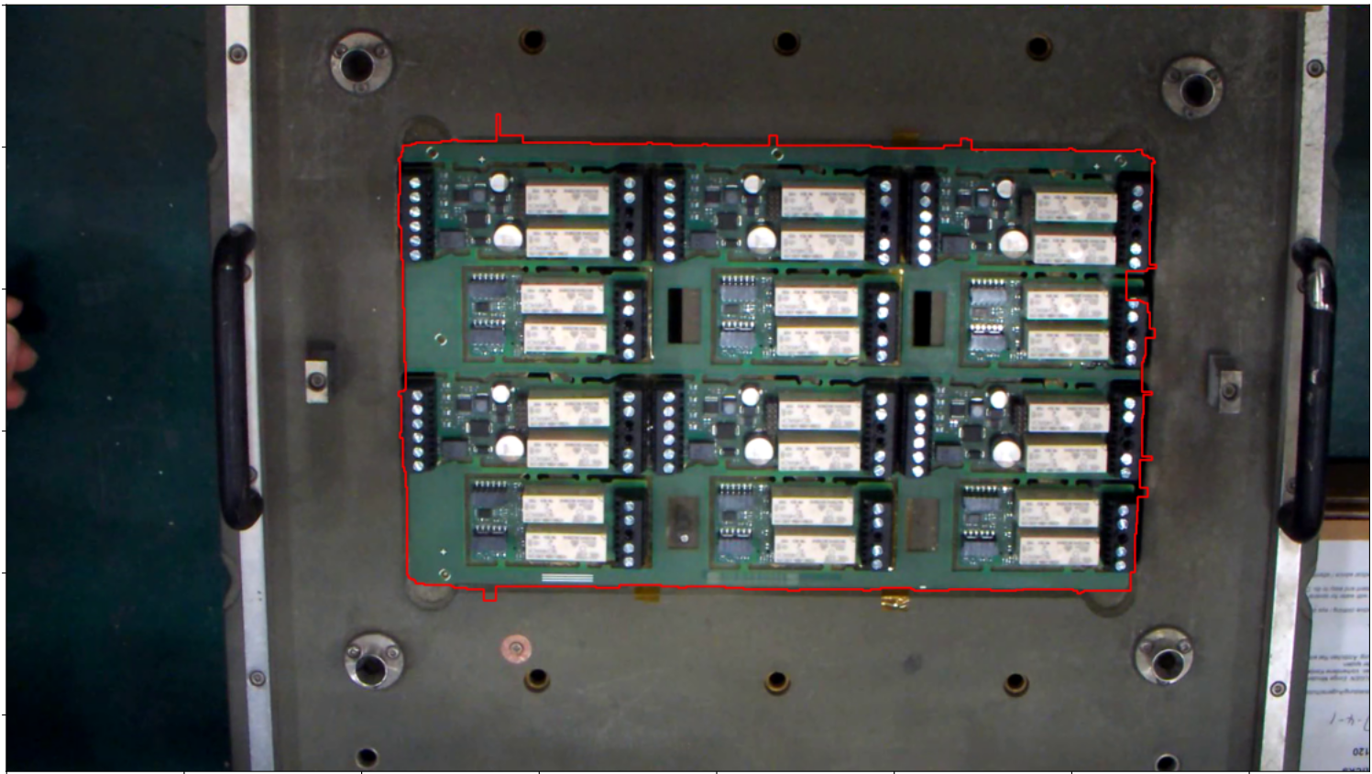
Challenges
Overview
Challenges
Bad environment
Triggering
Not fixed location
Flexible configs
Procedure
Demonstration
Future Directions
Solution
1. Raw Image From Camera
2. HSV Color Thresholding
3. Open-Close Iteration
4. Border Detection

Slide 13
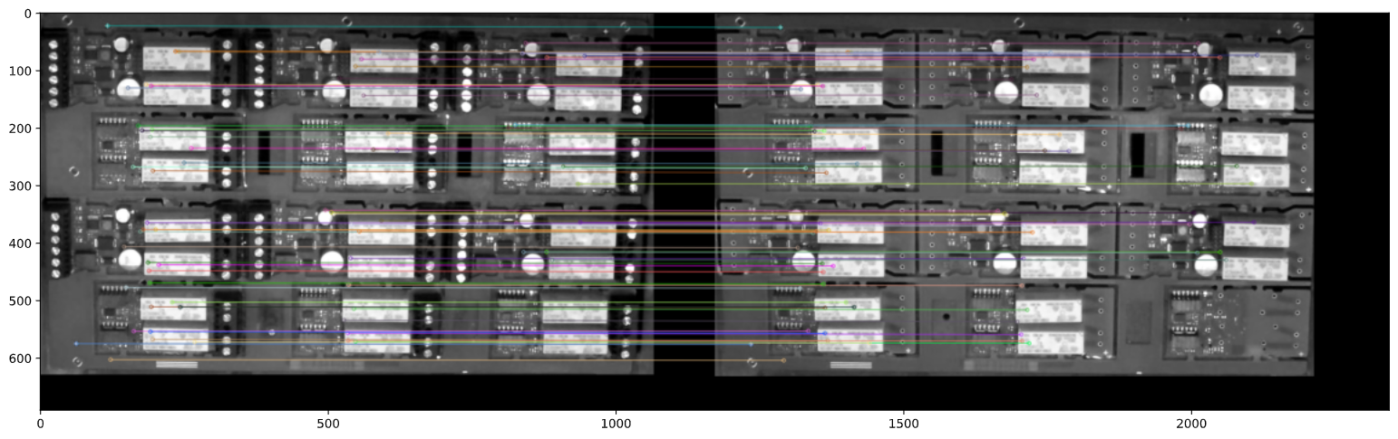
Challenges
Overview
Challenges
Bad environment
Triggering
Not fixed location
Flexible configs
Procedure
Demonstration
Future Directions
Solution
SIFT Detection and Transformation

Slide 14
Challenges
Overview
Challenges
Bad environment
Triggering
Not fixed location
Flexible configs
Procedure
Demonstration
Future Directions
Challenges: Must be easy to configure new PCB types
Solution:
Develop an application for easily creating or editing config files. Using this application would require no knowledges of programming.

Slide 15
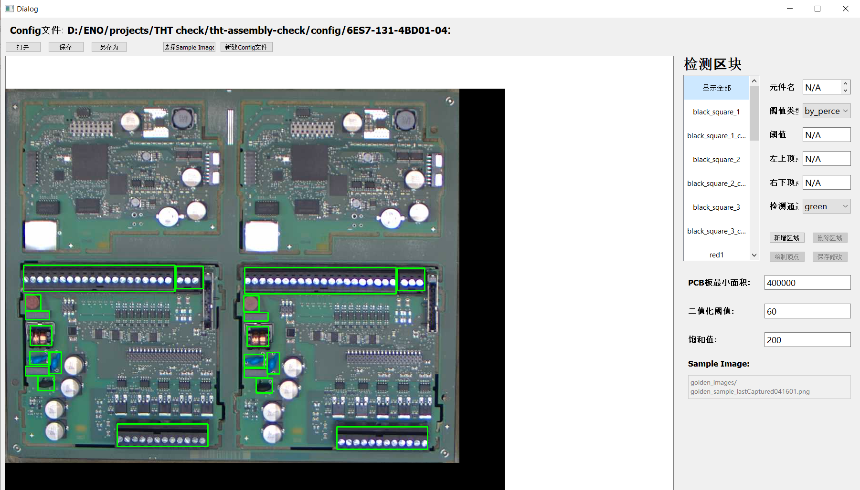
Challenges
Overview
Challenges
Bad environment
Triggering
Not fixed location
Flexible configs
Procedure
Demonstration
Future Directions
Challenges: Must be easy to configure new PCB types

Slide 16
Procedure
Overview
Challenges
Procedure
Demonstration
Future Directions
Procedure
User triggers image capturing with gesture
Find and crop the area with PCB
Alignment with sample image
Check each component with sample image
Get result (Pass/Fail), play sound feedback
Check complete, user proceeds to work

Slide 17
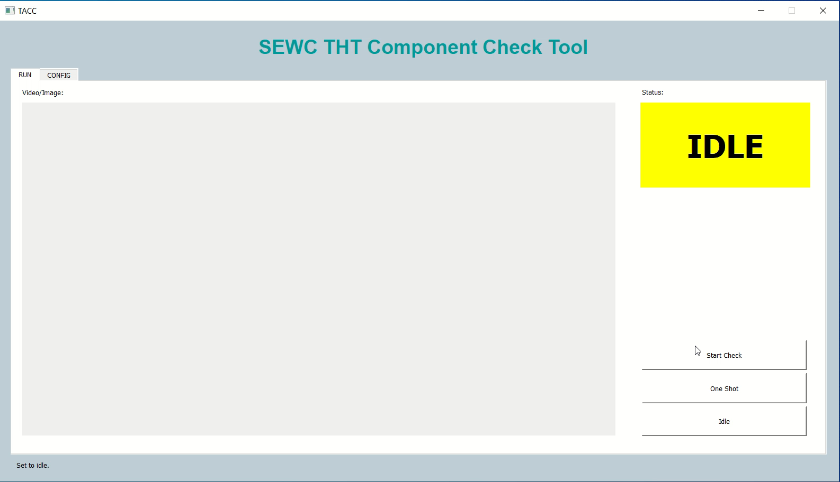
Demonstration
Overview
Challenges
Procedure
Demonstration
Future Directions
Demonstration
A small demo using recorded offline video: Pass case

Slide 18

Demonstration
Overview
Challenges
Procedure
Demonstration
Future Directions
Demonstration
A small demo using recorded offline video: Fail case

Slide 19
Future Directions
Overview
Challenges
Procedure
Demonstration
Future Directions
Future Directions
Auto detection of PCB type with AI
Automatically generating checkboxes and threshold with AI
More improvements based on workers’ feedback

Slide 20
THT Assembly Check using Computer Vision
Overview
Challenges
Procedure
Demonstration
Future Directions
Thank you!

